Slide 1
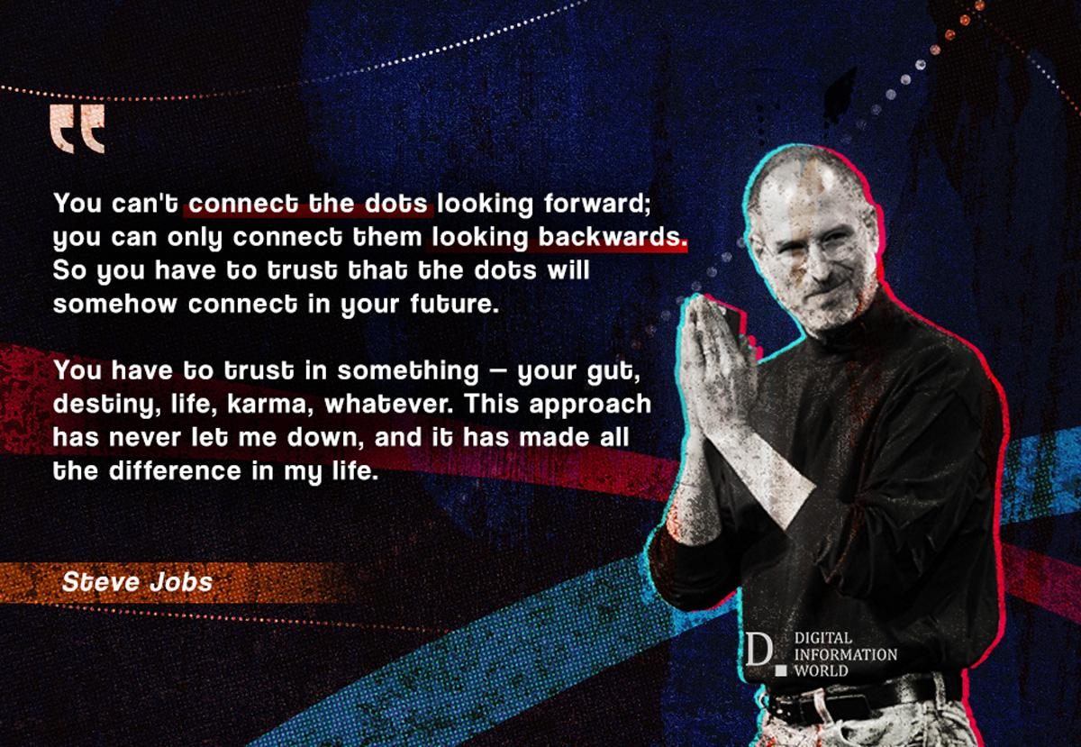

Slide 2
CIRCULAR ARRANGEMENT:

Slide 3
Seven friends P, Q, R, S, T, U and V are sitting in a circular table facing the center.
I. P is between T and U
II. V is between Q and R
III. S is left of U and Right of Q
Who is exactly right of R?
A. U
B. P
C. V
D. Q
TCS NQT 2020

Slide 4
Directions : Study the following information and answer the questions given below:
M, N, P, R, T, W, F and H are sitting around a circle facing the centre.
P is third to the left of M and second to the right of T. N is second to the right of P. R is second to the right of W, who is second to the right of M. F is not an immediate neighbour of P.
Who is to the immediate right of P? 1) H 2) F 3) R 4) Data inadequate 5) None of these
Who is to the immediate right of H? 1) R 2) F 3) M 4) Data inadequate 5) None of these

Slide 5
A, B, C, D, E, F, G and H are sitting around a circle facing the centre. F is third to the right of C and second to the left of H. D is not an immediate neighbour of C or H. E is on the immediate right of A, who is second to the right of G.
Q. Who sits between G and D?
1) H 2) D 3)F 4) E 5) None of these
Q. Which of the following is the correct position of B with respect to H?
Second to the right II. Fourth to the right
III. Fourth to the left IV. Second to the left
Only I 2) Only II
3) Only III 4) Both II & III 5) None of these

Slide 6
Ashwini, Priya, Sudha, Rani, Meeta, Geeta and Mukta are sitting around a circle facing the centre.
Ashwini is third to the left of Mukta and to the immediate right of Rani. Priya is second to the left of Geeta, who is not an immediate neighbour of Meeta.
1. Who is to the immediate right of Priya? 1) Meeta 2) Sudha 3) Mukta 4) Cannot be determined 5) None of these
2. Who is second to the left of Rani? 1) Ashwini 2) Meeta 3) Priya 4) Sudha 5) None of these
3. Which of the following pairs of persons has the first person sitting to the immediate left of the second person?
1) Rani-Meeta 2) Ashwini-Geeta 3) Sudha-Priya 4) Geeta-Sudha 5) None of these

Slide 7
Q.
A, B, C, D, E, F, G and H are sitting around a circle facing, the centre.
H is fourth to the left of B and second to the right of F.
A is third to the left of C, who is not an immediate neighbour of F.
G is second to the left of A.
D is second to the right of E
1. Who is on the immediate right of F?
1)H 2)A 3)G 4) Data inadequate 5) None of these
2. In which of the following pairs is the first person sitting on the immediate left of the second person?
1) EH 2) CE 3) AF 4) DB 5) None of these

Slide 8
A, B, C, D, E, F, G and H are sitting around a circle facing the centre.
B is third to the right of F and third to the left of H.
C is fourth to the left of A, who is not an immediate neighbour of F or B.
E is not an immediate neighbour of B.
G is second to the right of D
1. Who is to the immediate left of B? 1) D 2)G 3) D or G 4) Data inadequate 5) None of these
2. Who is to the immediate right of H? 1) A 2) E 3) F 4) Data inadequate 5) None of these
3. Which of the following pairs represents the immediate neighbours of F?
1) CH 2)ED 3) HD 4) CE 5) None of these

Slide 9
Seven friends P Q R S T U And V sit around a circle facing towards centre. Each of them score different marks in class test among 5, 6, 8, 9, 11, 12 and 14. Student with 6 marks sits 3rd to the right of V. Two persons sit between students with 6 and 11 marks.
P scored 9 marks and sits 2nd to the left of the student with 11 marks.
R sits 2nd to the right of P.T sits 2nd to the right of the student with 5 marks.
V Does not score the lowest .S sits 2nd to the left of the student with 8 marks.
Q scored the highest marks.
Q. 1 Who score 5 marks ?
Q.2 Sum of marks of Q and T ?
Q.3 Who sits 2nd to the right of P?

Slide 10
Previous Year TCS NQT : LOGICAL REASONING

Slide 11
Type 1: Comparison (Height, Weight) M.Imp for TCS NQT

Slide 12
Directions : Study the information and answer the following questions:
There are six people A,B,C,D,E and F. All of them have different heights
A is taller than F&D. B is shorter than only two people including A. A is not the tallest .C is taller than D but shorter than F.
The height of 2nd tallest person and the 2nd shortest person is 153 cm and 135 cm respectively.
Q1. What is the possible height of F?
(a)140 cm (b)165 cm (c)100 cm (d)134 cm (e)130 cm
Q2. Who among the following is the 3rs shortest?
(a)A (b)C (c)B (d)E (e)F

Slide 13
Directions :
There are 7 friends – A, B, C, D, E, F and G. All have different heights. B is taller than F but shorter than E. E is not the tallest. A is taller than both F and C. C is taller than G. A is taller than only 3 friends.
TCS NQT 2020
Who is the tallest of all friends? A) F B) G C) D D) B E)CND
2. C can be placed at how many possible positions in the arrangement obtained? A) Other than given in options B) One C) Two D) Three E)CND

Slide 14
DIRECTIONS Read the following information carefully and answer the questions given below it.
Six friends P, Q, R,S, T and U are members of a club and play a different game of - Football, Cricket, Tennis, Basketball, Badminton and Volleyball.
(ii) T, who is taller than P and S, plays Tennis. (iii) The tallest among them plays Basketball. (iv) The shortest among them plays Volleyball. (v) Q and S neither play Volleyball nor Basketball. (vi) R plays Volleyball. (vii) T is exactly between Q who plays Football and P in order of height. TCS NQT 2020
Who will be at the third place if they are arranged in descending order of their height ?
R T Q Not
Who among them plays Basketball?
Q T P U

Slide 15
Condition Based

Slide 16
A team of four players are to be selected from among four girls A,B,C,D and four boys P,Q,R,S such that there would be at least two girls in the team and the team selection should meet the following conditions
i. B cannot go with R
ii .D and P must go together
iii S cannot be put up with A
iv. R and C must be together TCS NQT 2020
A.QBSC
B.DAPQ
C.RCQS
D.BPRA

Slide 17
Each of the five students, P,Q,R,S and T studies two subjects from the given subjects named. History, Mathematics, English, Sanskrit, and Science. Each subject is studied by two students
i. P studies Mathematics and Sanskrit
ii. R studies History and Mathematics
iii. S and T both study English
iv. Q does not study science
TCS NQT 2020
Who from the given option studies science? A. P B. Q C. R D. S

Slide 18
While Balbir had his back turned, a dog ran into his butcher shop, snatched a piece of meat off the counter and ran off. Balbir was mad when he realised what had happened. He asked three other shopkeepers, who had seen the dog, to describe it. The shopkeepers really didn’t want to help Balbir. So each of them made a statement which contained one truth and one lie. A. Shopkeeper Number 1 said: “The dog had black hair and a long tail.” B. Shopkeeper Number 2 said: “The dog had a short tail and wore a collar.” C. Shopkeeper Number 3 said: “The dog had white hair and no collar.” Based on the above statements, which of the following could be a correct description?
Option (A)
The dog had white hair, short tail and no collar.
Option (B)
The dog had white hair, long tail and a collar.
Option(C)
The dog had black hair, long tail and a collar.
Option(D)
The dog had black hair, long tail and no collar. CAT 2001

Slide 19
Five plays A, B, C, D and E were organised in a week from Monday to Saturday with one play each day and No play was organised on one of these days.
Play D was organised before Thursday but after Monday.
Play E was organised on Saturday.
Play C was Not organised on the first day.
Play B was organised on the next day on which Play C was organized.
Play A was organised on Tuesday
Q. On which day No Play was organised?
Q. Which play was organized on Wednesday?

Slide 20
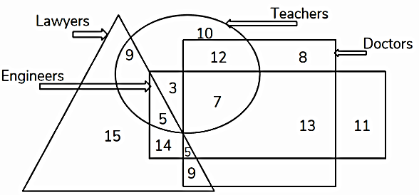
TCS TCS NQT 2020
How many engineers are lawyers as well as doctors?
A. 9
B. 14
C. 7
D. 5

Slide 21
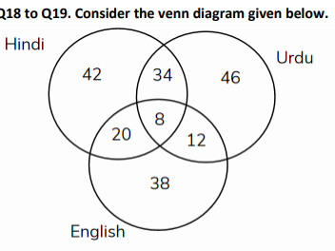
The number in the Venn diagram indicates the number of persons who can speak various languages in a city. The diagram is drawn after surveying 200 persons. In a population of 15,000. How many people can be expected to speak just one language?
A. 8400 B. 9450 C. 9600 D. 8750
TCS TCS NQT 2020 | 25th Oct 12:30 pm to 3:30 pm Slot Analysis

Slide 22
The number in the Venn diagram indicates the number of persons who can speak various languages in a city. The diagram is drawn after surveying 200 persons. In a population of 15,000. How many people can be expected to speak at least two languages?
TCS TCS NQT 2020 | 25th Oct 12:30 pm to 3:30 pm Slot Analysis

Slide 23
Arrangements:

Slide 24
Six people A, B, C, D, E and F are sitting on the ground in a hexagonal shape. All the sides of the hexagon so formed are of same length.
A is not adjacent to B or C
D is not adjacent to C or E
B and C are adjacent
F is in the middle of D and C.
Which of the following is not a correct neighbor pair? (A) A and F (B) D and F (C) B and E (D) C and F

Slide 25
Among six persons A, B, C, D, E and F standing around a circle, some of them are facing the centre while others are facing outside (i.e. opposite to the centre).
C stands second to the right of E. E faces outside. C is an immediate neighbour of both D and B. F stands second to the left of D. D faces the same direction as E.
What is the position of A with respect of E?

Slide 26
